Slide 1
Sauce & Spoon
Tablet Rollout
Impact report

Slide 2
Executive Summary
Sauce & Spoon wants to launch a pilot rollout of tabletop menu tablets at two of restaurant locations, Sauce & Spoon North and Sauce & Spoon Downtown. The project includes researching and selecting a tablet and a vendors, adding a revamped menu and special features to the tablets, training staff, and installing them at bar of two locations. The system will be rolled out at the beginning of quarter 2 in April, and monitored through the end of june to gauge success.
Methodology: We use a waterfall approach for the entire project, with aspects of the agile mentality applied, like preparing for changes and staying flexible with our schedule and budget.

Slide 3
Accomplishment Summary
We reduced the average table wait time to under 10 minutes.
We eventually reduced the table turn time by 30 minutes.
The average table checkout time has stayed at one minutes or less.
Archived less than 5% of customers report technical issues each.
Increased daily guest count by 20% in Downtown location.
We just succeeded in reducing food waste by 25%.

Slide 4
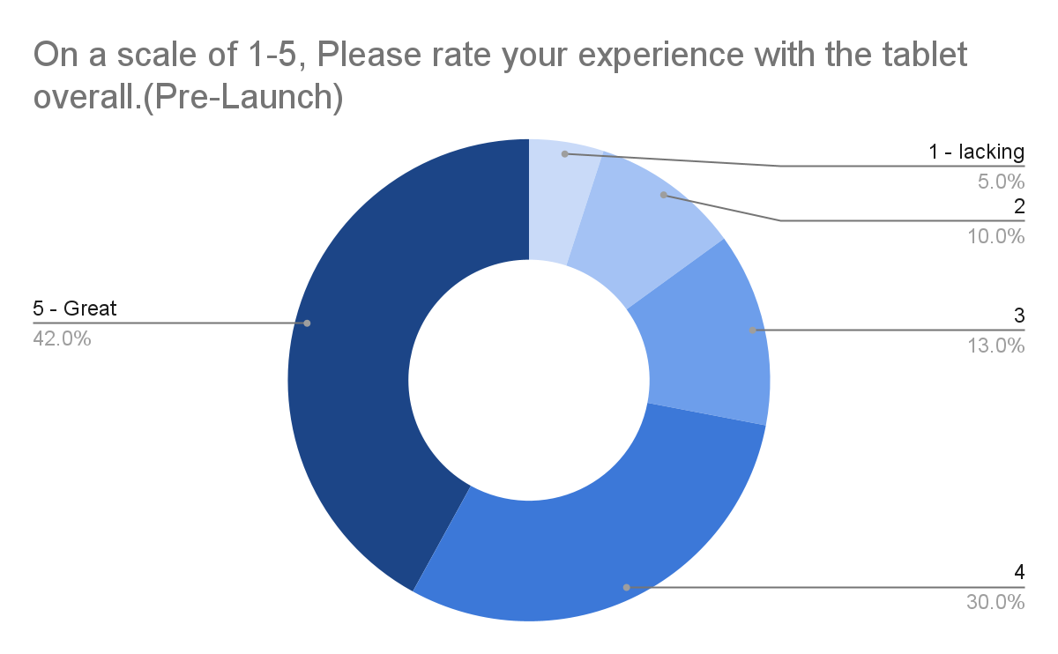
Customer Satisfaction: Pilot
This pie chart illustrates the results from the post-pilot survey. 72% of respondents indicated a customer satisfaction score of 4 or 5.

Slide 5
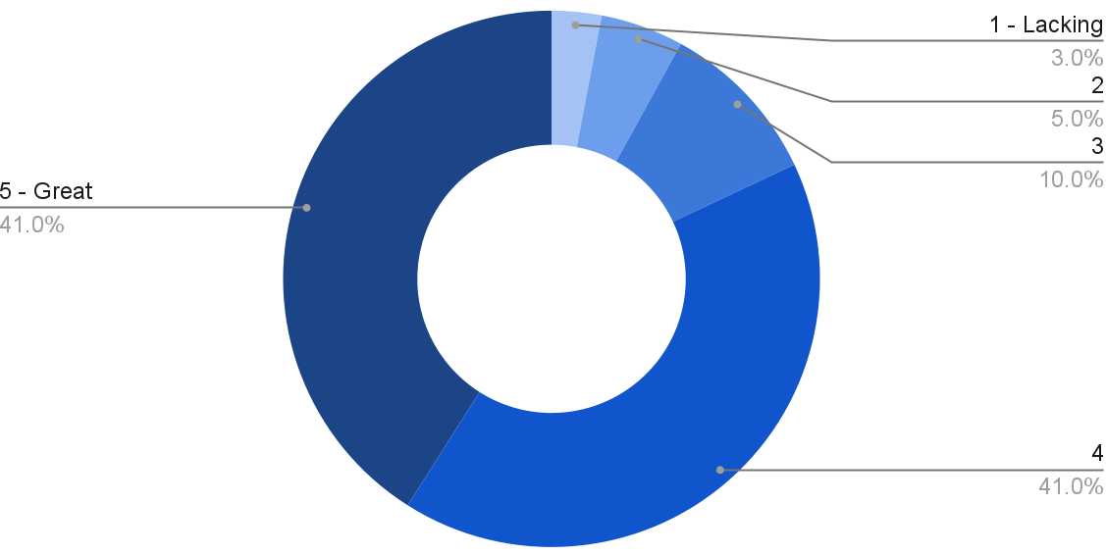
Customer Satisfaction: Launch
This pie chart illustrates the results from the post-launch survey. 86% of respondents indicated a customer satisfaction score of 4 or 5. This is a 14% increase.

Slide 6
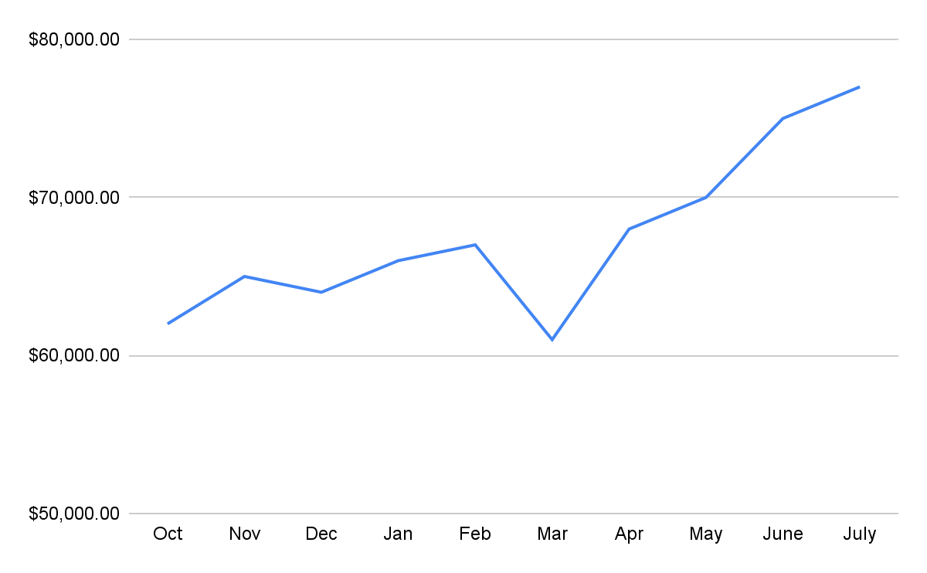
Revenue
Tablet Launch April 23
This is a chart of Sauce & Spoon of Revenue were we can see that after implementation of a tablet the annual growth rate increases by 20%

Slide 7
What Worked: Key Accomplishments
Decreased table turn time Implementation of the tablets increased the average daily guest count by 10% Tablets also decreases the wait time by 30 minutes. | Increased Customer Satisfaction After the pilot, Customer satisfaction was at 72% Once we implemented improvements based on customer feedback, customer satisfaction increased to 86%
Decreased food waste Tablets identified who was receiving the incorrect order. Kitchen staff has taken the initiative to correct the order and decreases the food waste by 50% | Increased sales Our monthly revenue has increased steadily since the tablet rollout, Upwards of 20% since september/Pre-rollout Tablets also helped boost revenue during the holiday season.

Slide 8
Next Steps: Looking Forward
Plan for the roll out for the rest of the locations.
Continue to monitor and update installed tablets.
Work to get Waterfront location to increase the guest count by over 20%.
Continue to improve order accuracy.
Continue to generate surveys and solicit guest feedback.

Slide 9
Next Steps: Initiative & Action
Initiative | Action | Date
Implement tablets in more locations | Create new project plans for new locations | Q2
Continue to track customer experience & satisfaction | Continue surveying and gathering data through various means | Ongoing
Expand tablet features | Investigate new features like social media integration, reservation, videos, etc. | Q4

Slide 10
Lessons Learned
Our guests seemed to have some trouble with the navigation, so we switched to a layout that they find simpler.
After struggling to reduce table turn time, we worked with the general managers on training and getting waitstaff to be more aware of guest pacing. This allows us to eventually reduce turn turn time by the desired 30 minutes.
Our cash payment system is still leaving customers frustrated, and we implemented more registers and retrained staff to address the issue.

Slide 11
Appendix
Project Proposal
Project Charter
Stakeholder Analysis
Project Plan
Survey Results
Survey Results Presentations

